Slide 1
Git And GitHub
By vishal s. Pimple

Slide 2
What is Git and Github?
Git tool used for source code management
Git stores your source code and its full development history locally in a repository.
Git is a distributed, open-source version control system (VCS) that enables you to store code
It also helps merge code changes, and revert to earlier code version when needed.

Slide 3
What is github
today, GitHub is one of the most popular resources for developers to share code and work on projects together. It’s free, easy to use, and has become central in the movement toward open-source software.
GitHub is a code hosting platform for collaboration and version control.
GitHub lets you (and others) work together on projects

Slide 4
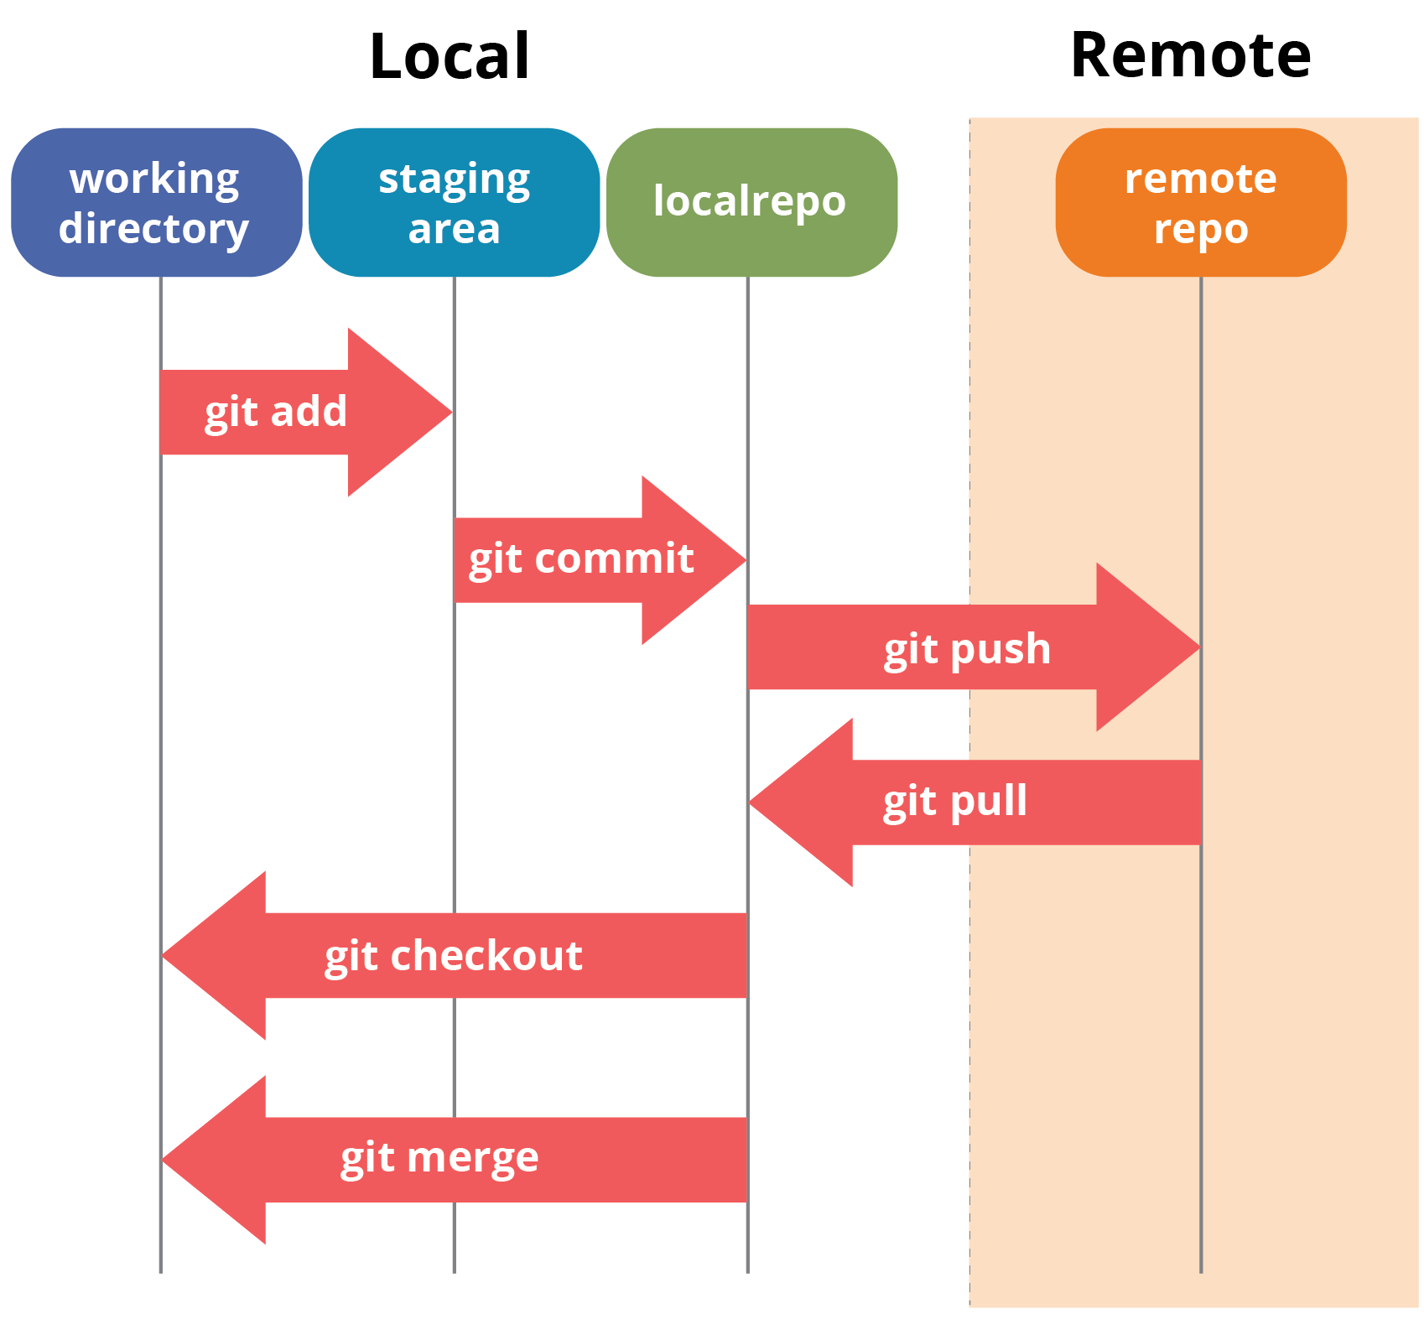
Git working

Slide 5
commmands
$ git --version
$git init
$git config --global user.name "VishStrong"
$git config --global user.Email "vishalpimple0001@gmail.com"
$ git remote add origin https://github.com/sushmithakongi/Infobell-Openshift-Daily-Work.git

Slide 6
important
git pull origin VishalP
git branch VishalP
git checkout VishalP
git add .
git commit -m "first commit"
git push origin VishalP

Slide 7
commands
$git clone url
$git pull <name>
$Git branch
$Git branch <branchName>
$git checkout <branch name>
Git merge <branch name>

Slide 8
Ignoring files
.gitignore file is used for ignoring the file for adding and commiting
Ex.
*.css
*py
*.html

Slide 9
Other helpfull
Git status
Git log
Git log –oneline
Git remote show
Git remote rm origin
Git revert <commit Id>
Git reset –hard

Slide 10


